Slide 1
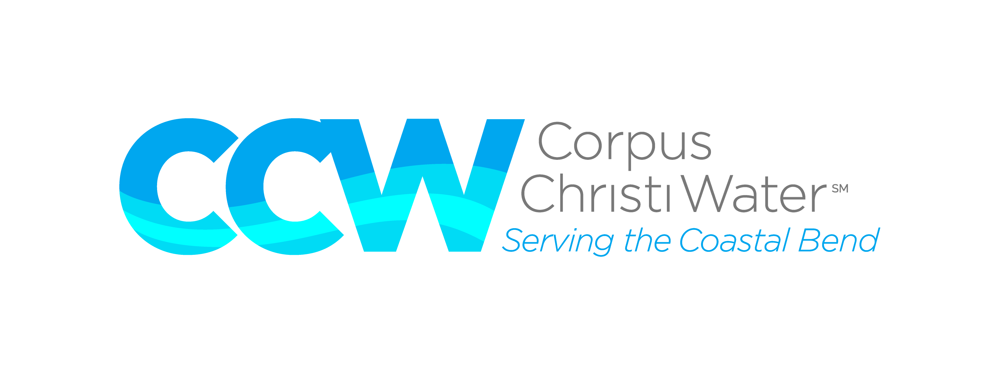
Drought Outlook and Barney Davis Site Evaluation Update for Corpus Christi City Council
Michael Murphy, COO
March 28, 2023

Slide 2
2

Slide 3
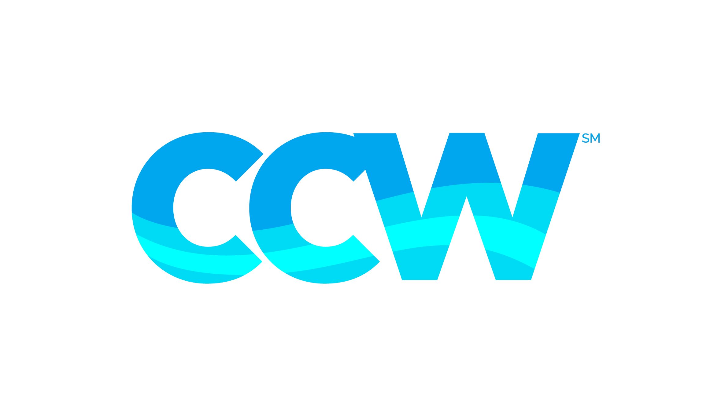
Water Sources
CCW produced an average of 80 million gallons per day (MGD) last fiscal year.
Surface water resources:
Lake Texana (Mary Rhodes Pipeline).
Colorado River (Mary Rhodes Pipeline Phase II).
Nueces River.
Choke Canyon Reservoir (CCR).
Lake Corpus Christi (LCC).
3

Slide 4
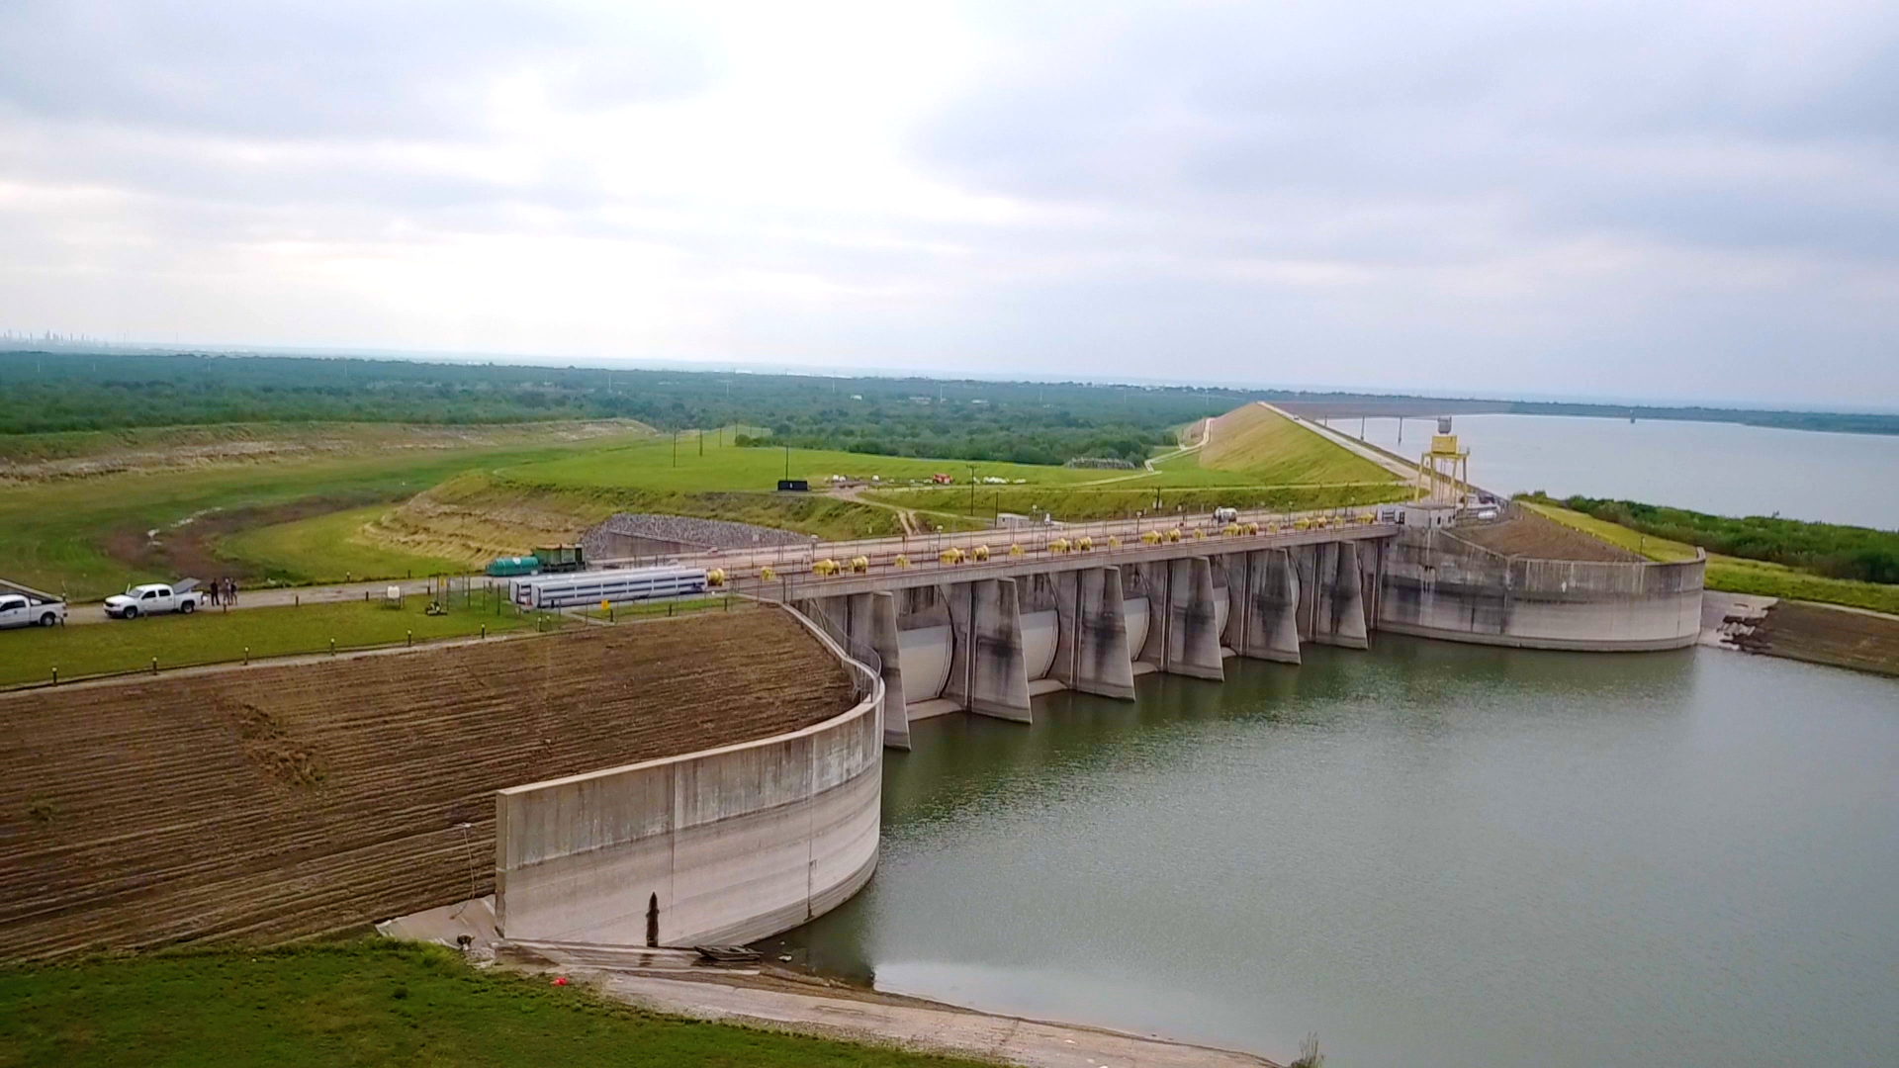
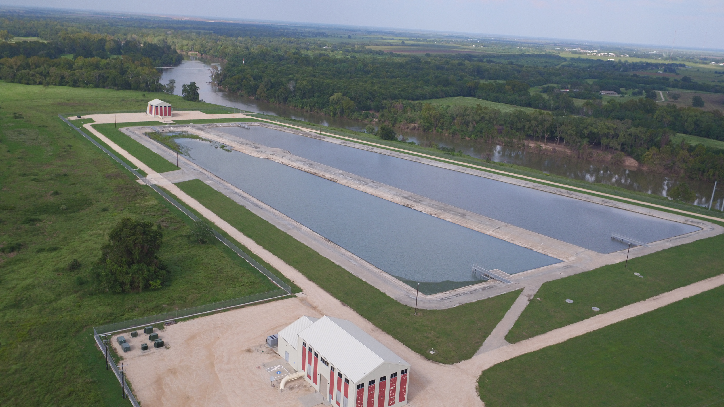
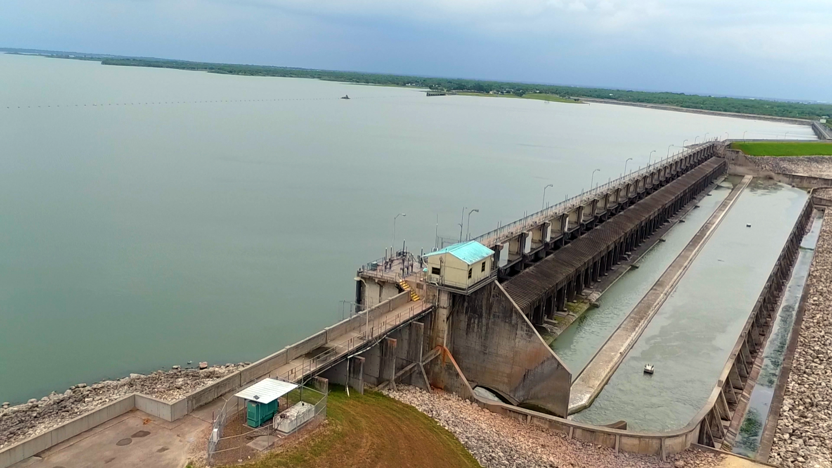
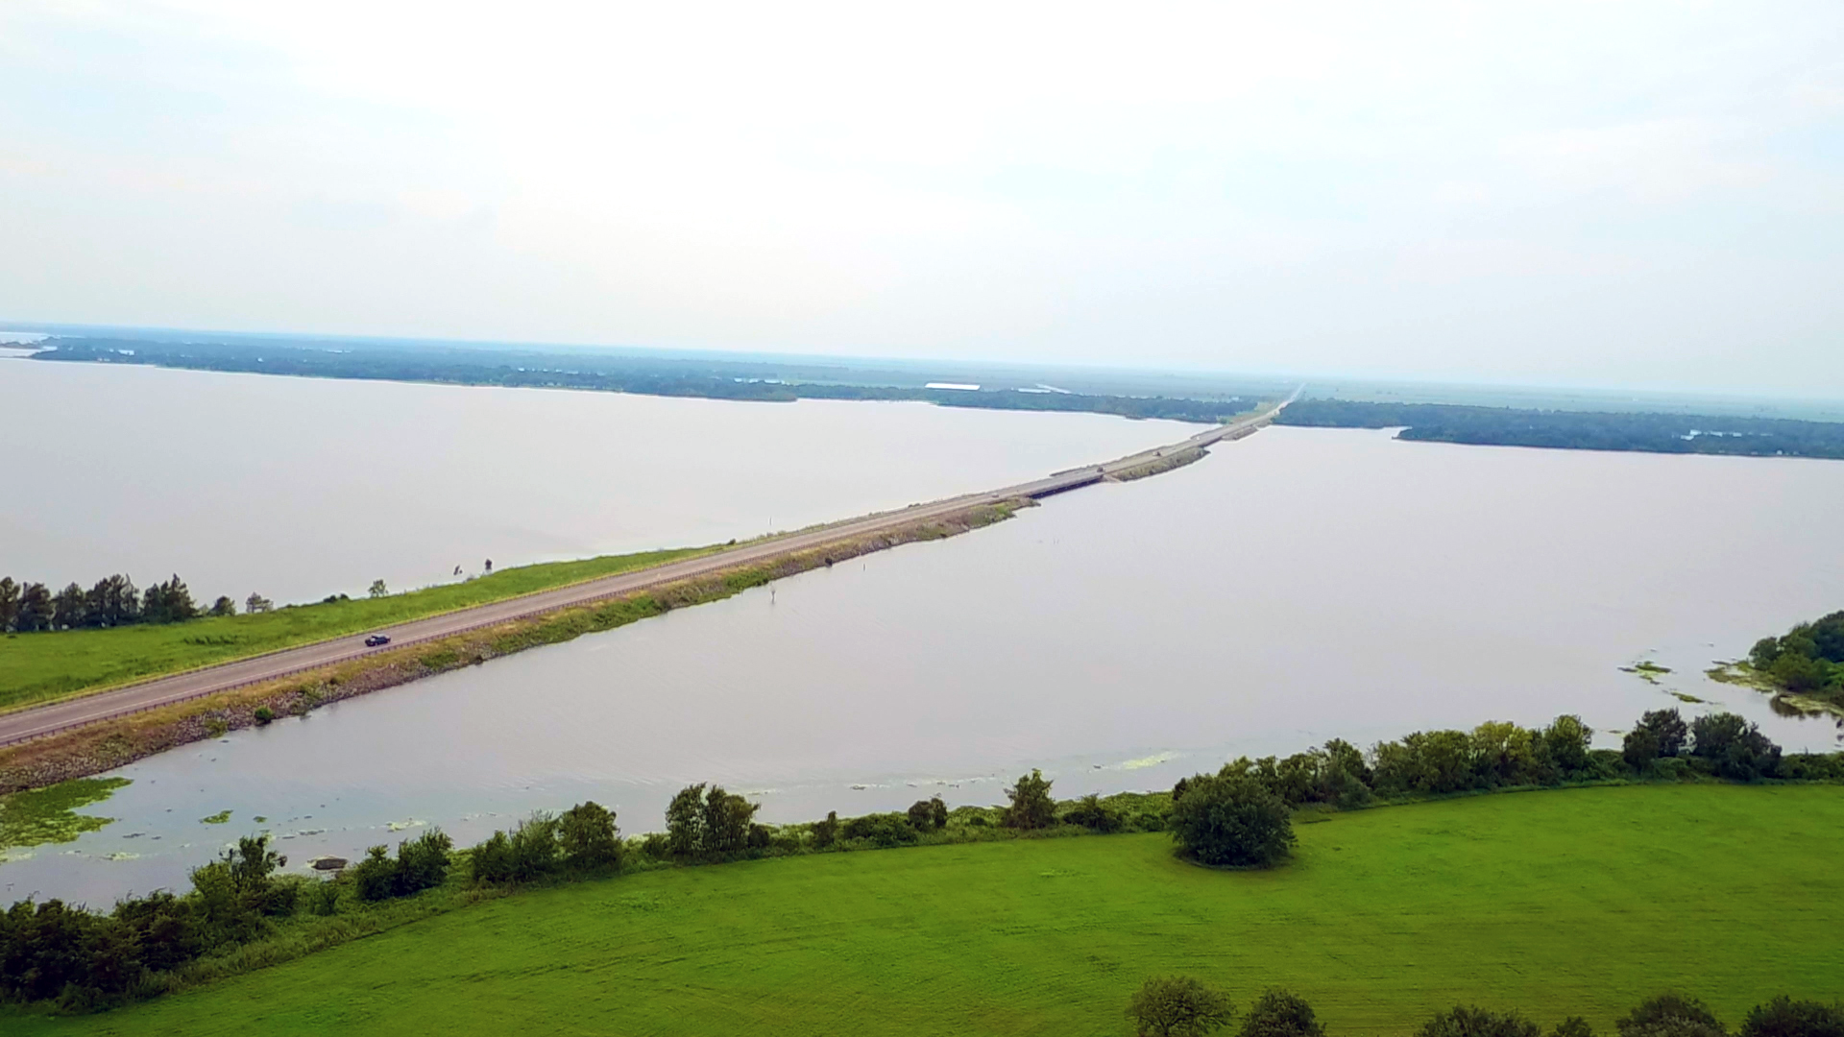
Nueces River
Choke Canyon Reservoir
Colorado River
Mary Rhodes II
Full Capacity:
662,821 acre-ft
Run of the river
Water Rights:
35,000 acre-ft
Lake Texana
Mary Rhodes
Nueces River
Lake Corpus Christi
Full Capacity:
158,975 acre-ft
Contract Amount: 31,440 acre-ft
Full Capacity:
256,339 acre-ft
4

Slide 5
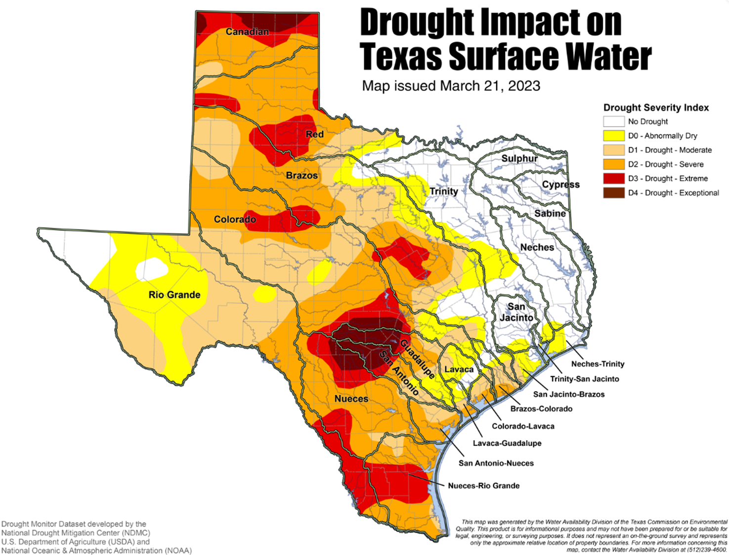
Recharge Zones
5

Slide 6
Ongoing Drought in Texas
6

Slide 7
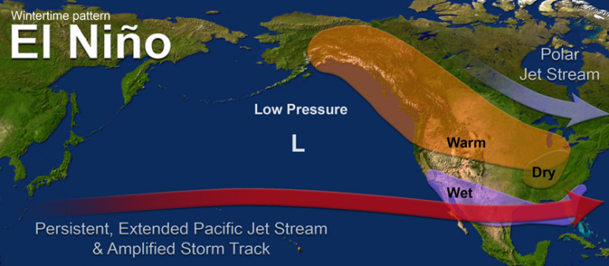
National Weather Service Update
https://www.weather.gov/crp/drought
7

Slide 8
8

Slide 9
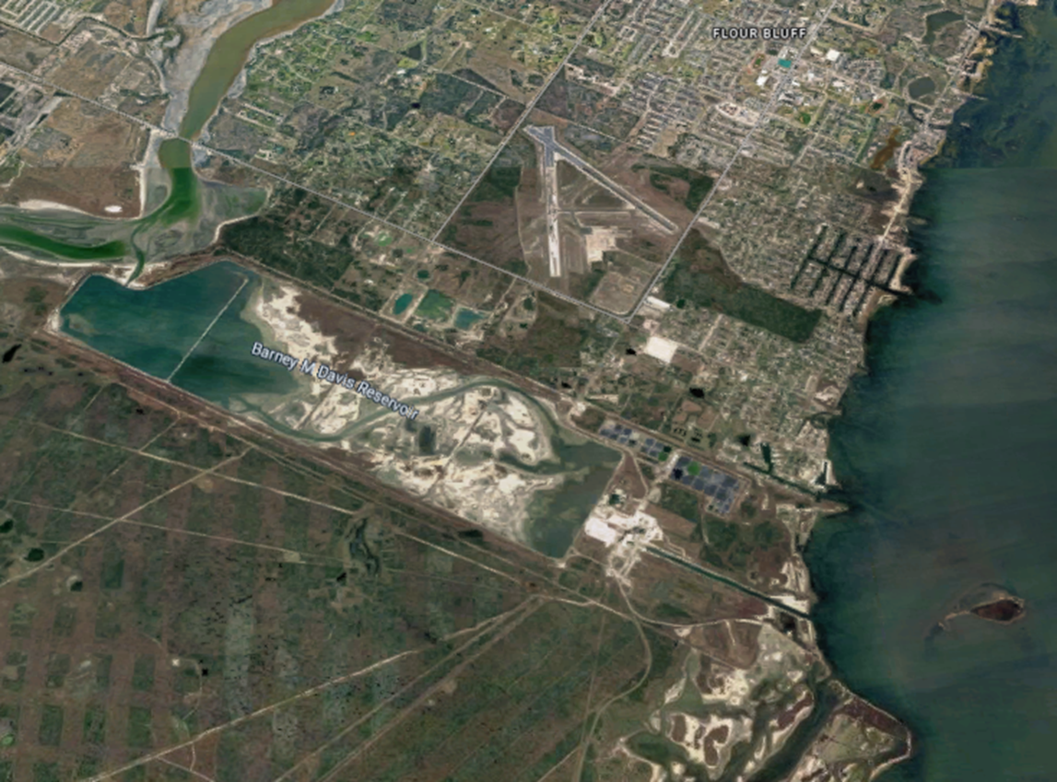
Barney Davis Site Evaluation Update
HDR site assessment is underway.
Target Capacity: 20 MGD.
Project is located near the Barney Davis power facility.
9

Slide 10
Barney Davis Site Assessment Scope
Data evaluation.
Developing treated water quality goals.
Environmental permitting analysis at Oso Creek and Oso Bay.
Desalination facility conceptual design including flow diagrams and flow rates.
Budgeting.
Project management.
Technical memorandum.
10

Slide 11
Thank you!
11

