Slide 1
Drought Contingency Plan Update Corpus Christi City Council August 9, 2022

Slide 2
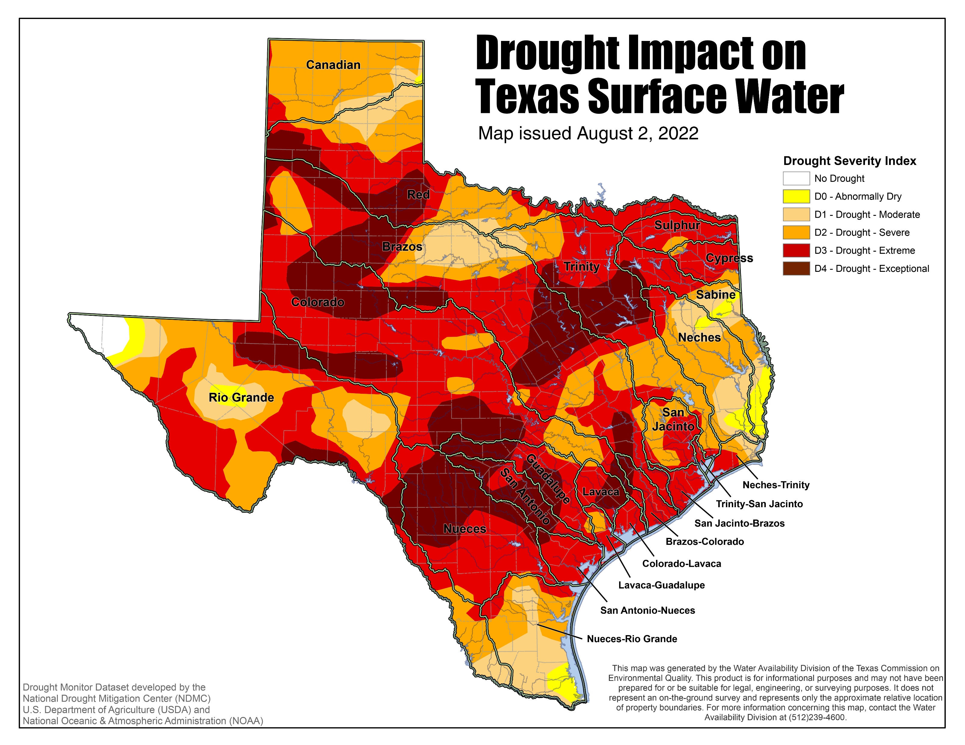
Severe to Extreme Drought is occurring across Nueces County
Extreme to Exceptional Drought is occurring across the upper Nueces River Basin

Slide 5
Reservoir Capacities – Last Year and Today

Slide 6
Production from O.N. Stevens Water Treatment Plant
Reservoir Capacities - Historical
MGD

Slide 7
Reservoir Capacities - Historical

Slide 8
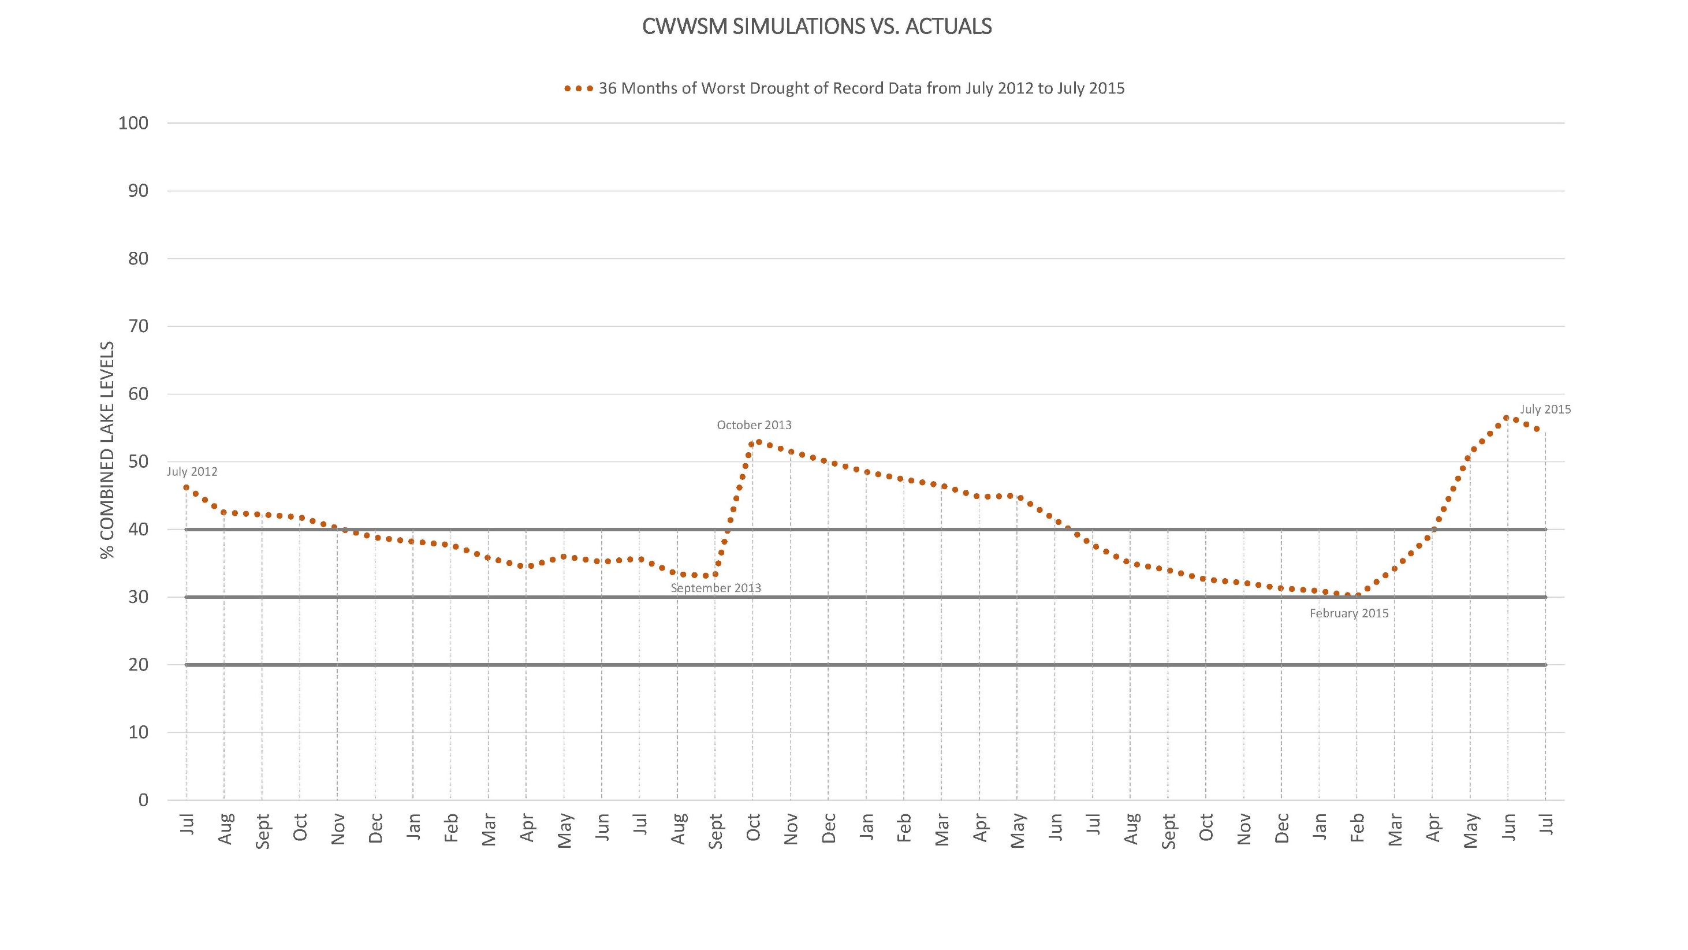

Slide 9
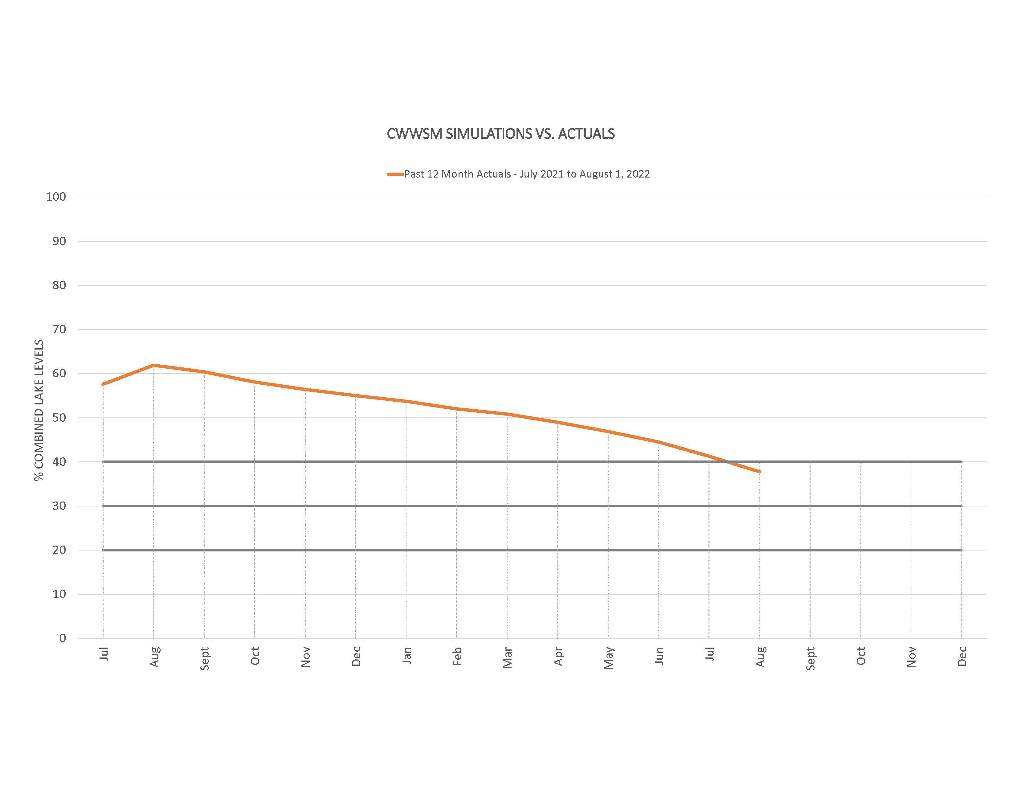

Slide 10
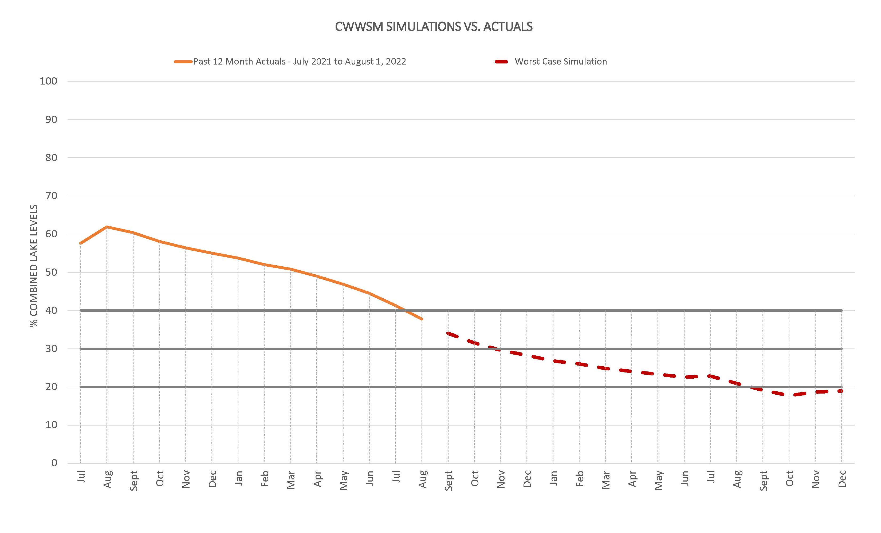

Slide 11
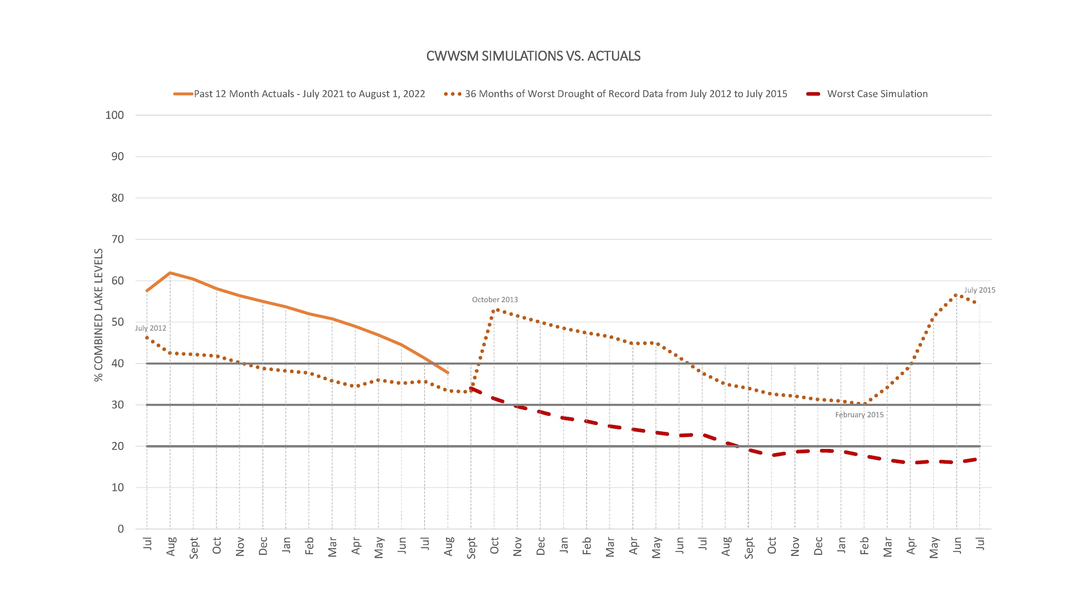

Slide 14
Communication
Revamping our website and creating a dashboard which will have information on lake levels, daily usage and information on how everyone can save water
Meeting with our large volume customers
Meeting with officials from smaller cities in the area that receive water directly or indirectly from Corpus Christi Water
We are going to hold a media event in the next two weeks as our lake levels approach 35%
Continued media interviews (24 since Stage 1 began), social media posts, Facebook live, utility bill messaging, billboards and more
Continued enforcement of water restrictions – 550 citations as of Monday

Slide 15
Key messages
This drought is real
We control how much water we use – we do NOT control the weather
We are in this together
Using less water is key

