Slide 1
Texas Commission on Environmental Quality 2001 Agreed Order Briefing Corpus Christi City Council August 23, 2022

Slide 2
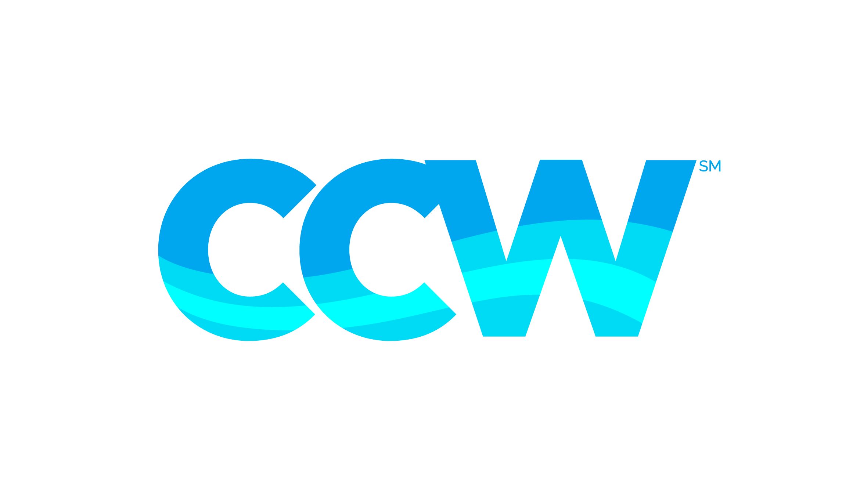
What is the Agreed Order?
11-page agreement between City of Corpus Christi, City of Three Rivers and the Nueces River Authority established in 2001 through Texas Natural Resource Conservation Commission (TNRCC)
It’s a mechanism for the Pass-thru of water for environmental purposes but also a tool for protecting our water supply
Goals and Objectives of the Agreed Order
Preserve the ecological environment and health of related natural resources in the Nueces River Basin and Nueces Estuary
Maintain and protect water supply to meet demands in the Coastal Bend
Protect the economic interest of all citizens that are dependent upon the Choke Canyon/Lake Corpus Christi Reservoir system and the Nueces Estuary
2

Slide 3
Sources of Water

Slide 4
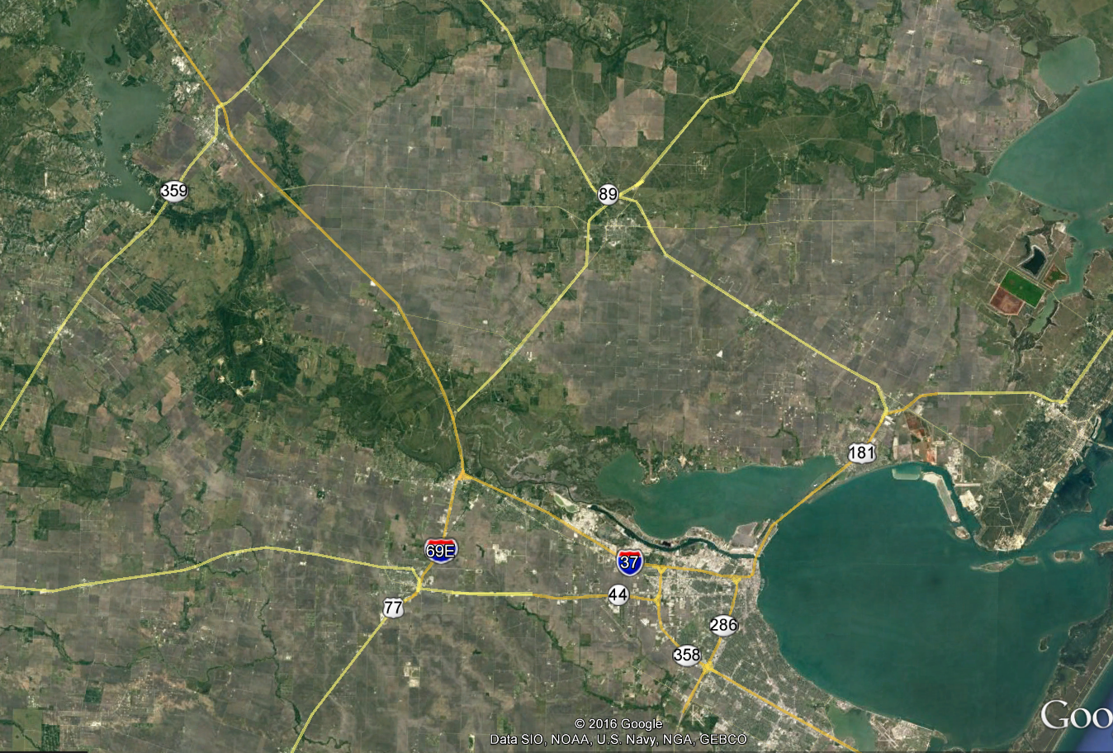
Nueces River and Delta
Lake Corpus Christi
Nueces River
Nueces River Delta
Nueces Bay
Corpus Christi Bay

Slide 5
Definitions
Inflow
Water that flows into reservoirs
Pass-thru
Water that has flowed into reservoirs, up to a target amount, and is let out to meet freshwater requirements
Release
Water stored in reservoirs and let out to meet daily needs
Spill
Water let out because reservoirs are full
5

Slide 6
History of Agreed Order
Certificate of Adjudication 21-3214 (surface water permit) in 1976 led to the creation of Choke Canyon Reservoir
The Certificate of Adjudication includes Special Condition 5.B
Special Condition 5.B says scheduled releases, combined with return flows and spills, from the reservoir system shall provide not less than 151-thousand acre-feet of water to Nueces and Corpus Christi Bays estuaries to maintain the environment and health of marine life
6

Slide 7
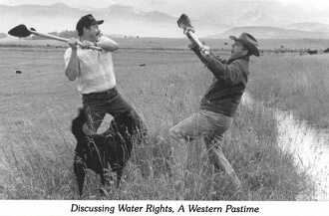
History of Agreed Order (cont.)
Texas Natural Resource Conservation Commission (TNRCC)
1990 - Initial Orders
1992 - Interim Agreed Order
1995 - Final Agreed Order
Changed to pass-thrus rather than releases from storage
2001 - Amended Agreed Order
Requested by City of Corpus Christi and Nueces River Authority
Allows reduction of pass-thrus based on total reservoir system capacity and when mandatory outdoor water restrictions are in place
7

Slide 8
Pass-Thru Requirements
Measured inflow into the Choke Canyon/Lake Corpus Christi Reservoir System, up to a target amount, is required to be passed through to bays and estuaries
Target Amounts
Dependent on several variables:
Measured inflow into the reservoir system (rain)
Percent capacity of the reservoir system
Month of the year
Salinity relief credit
Return flow credit
No release of stored water is required to meet target amount
8

Slide 9
Monthly Targets for Pass-Thrus
9

Slide 10
2022 Pass-Thrus
10

Slide 11
Pass-Thru Report
Nueces River Authority – Water for the Future (nueces-ra.org)
11

Slide 12
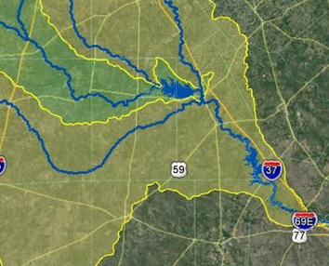
How are the inflows into the reservoir system monitored and measured?
SMTT
ARWT
FRTT
CCR
NTRT
NRTT
12

Slide 13
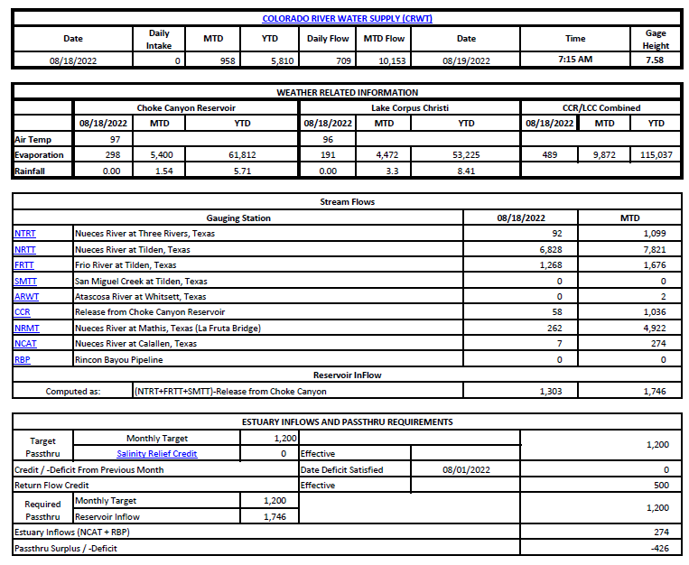
Pass-Thru Report
13

Slide 14
Takeaway
The State established an environmental flow condition
The pass-thru requirement has been modified several times since 1976
Monitoring system in place with multiple points
Daily and monthly inflow and pass-thru reports are posted on the Nueces River Authority’s website
14

Slide 15
Why hasn’t the agreed order been modified in 20 years?
Water released due to pass-thru won’t keep us out of drought
The agreed order protects the City during droughts by reducing or eliminating the target pass-thrus
It’s good for the downstream environment
Why do I see water moving over the Calallen Dam?
When water is passed-thru to meet environmental flows
When rain falls below Lake Corpus Christi
15

Slide 16
Questions
16

Slide 17
Intentionally left blank
17

Slide 18
How do salinity levels in Nueces Bay affect target amount?
If the salinity levels at the official monitoring site meets specific criteria, which varies by month, then a salinity relief credit can reduce the target amount
Example:​
In July 2016, the average salinity for 10 consecutive days was below 15 ppt, so the target was reduced by 50%​
In March 2016, the average salinity for 10 consecutive days was below 25 ppt, so the target was reduced by 25%​
Note: The City can use the salinity relief credit OR the surplus in any given month but not both
18

