Slide 1


April 18, 2023
City of Corpus Christi and
Port of Corpus Christi Water Source(s) Collaboration Update
Corpus Christi City Council Presentation
Presented by

Slide 2

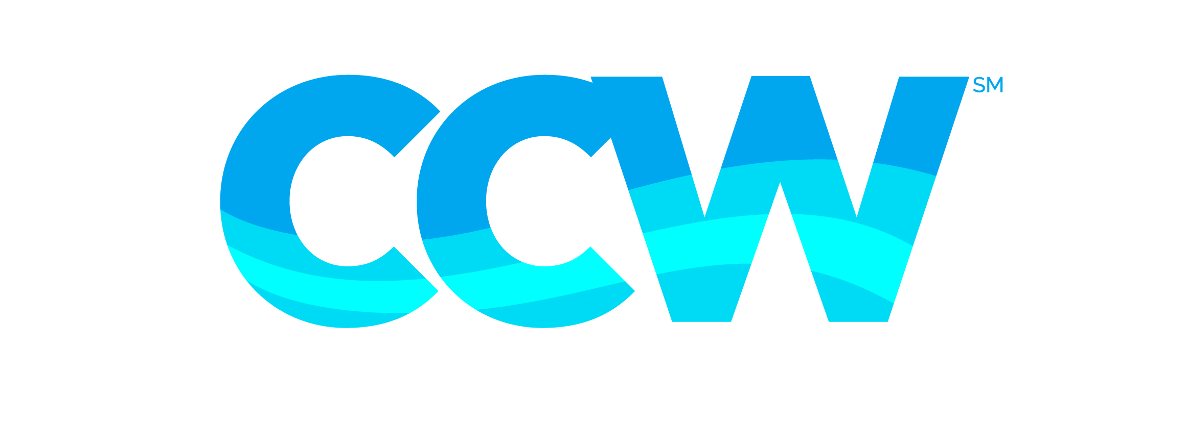
Framework
March 21, 2023 - Corpus Christi City Council (The City) approves a Motion “directing the City Manager to work out a framework on how the Port of Corpus Christi can assist the City of Corpus Christi in pursuit of desalination and other water resources for the long-term growth of the City of Corpus Christi and the Coastal Bend.”
March 21, 2023 – Port of Corpus Christi (The Port) Commissioners approve a Memorandum of Understanding (MOU) “to provide a framework for collaboration between the City and the Port for the pursuit of drought resistant water supplies for the long-term growth of the Coastal Bend. This MOU affirms the City’s position as the regional water supplier. This MOU will set forth the expectation for equally sharing of all costs associated with the development of drought resistant water supplies.”
Presented by
2

Slide 3
Collaboration Update
Water sources that will be reviewed and collaborated on include, but are not limited to:
  Inner Harbor Seawater Desalination
  Harbor Island Seawater Desalination
  La Quinta Seawater Desalination
  Barney Davis Seawater Desalination
  Evangeline Groundwater
To date, City Manager (CM) and Port Chief Executive Officer (CEO) have met numerous times:
  One-on-one meetings
  Site visits to the Harbor Island location
  Phone Conversations
Presented by
3

Slide 4
Collaborative Actions
Verbal agreement between CM and Port CEO:
  Review Harbor Island and determine rates for water
  CM recommended an engineering firm to Port CEO for further study of how a Harbor Island Desalination Plant could be tied into the City water distribution infrastructure
  Continue to pursue Inner Harbor
  Continue to pursue La Quinta
  Evaluate Barney Davis
  Evaluate Evangeline
Water Development Board Funding – Senate Bill 28
Upcoming site visits with Council Members, Port Commissioners:
  Harbor Island site tour - Wednesday, April 19
  Inner Harbor Desalination site - April 21, April 28, May 5
  Barney Davis – To be scheduled
Presented by
4

Slide 5
Executive Summary
A team of experts guided the project development process, including permitting and regulatory assessment, technology review, site planning, and cost analysis.
Harbor Island Desalination Project Overview
The Port of Corpus Christi has been working with stakeholders, potential customers, and other local constituents to develop a desalination facility on Harbor Island, which will help solve the Corpus Christi Area surface water issue.
Currently 100% reliant on surface water
Significant water shortages predicted in the near term
Drought-proof and sustainable water supply
for the Corpus Christi Area
Cost effective, environmentally cautious, and using state-of-the-art technology
Planned for 50 MGD production with ability
to expand to 100 MGD
Potential public private partnership with
third-party operator
Expect to complete permit process and
begin construction in 2024
Presented by
5

Slide 6
Permitting and Regulatory Assessment
PROCESS FOR DESALINATION PROJECT DEVELOPMENT
WHAT PERMITS ARE REQUIRED:
PERMIT APPLICATION REQUIREMENTS:
Texas Pollutant Discharge Elimination System for discharge from outfall (TCEQ*)
Submerged land lease for intake (TxGLO**)
Easement for intake tunnel (TxGLO)
Water Rights Permit (TCEQ)
Clean Water Act 404 Permit for intake and
outfall (U.S. Army Corps of Engineers)
Site layout and design
Intake and discharge technology and routes
Water quality sampling and modeling
Environmental and ecological assessment
*Texas Commission on Environmental Quality
**Texas General Land Office
Presented by
6

Slide 7
Permit Materials and Status
PROCESS FOR DESALINATION PROJECT DEVELOPMENT
Port of Corpus Christi experts developed
research-backed reports and plans to support robust permit applications:
STATUS OF PENDING APPLICATIONS:
TPDES Permit Issued – Awaiting EPA concurrence
Water Rights administratively complete
Lease and Easement applications submitted
to TXGLO
CWA 404 Application submitted to Army
Corp of Engineers
Building and pipeline permitting approvals may be sought closer to construction
Water Conservation and Drought
Contingency Plans
Impingement & Entrainment Report
Threatened & Endangered Species
Basis of Design Report
Conceptual Designs
Construction Methodology and Conditions
Presented by
7

Slide 8
Cost Analysis
Summary of Analysis
Port of Corpus Christi consultants and experts evaluated costs associated with siting, installation, and technology options.
  Tunnel boring method is cost effective for both 50 and 100 MGD
  Intake tunnel sized for 50 MGD will be sufficient for 100 MGD
  Desalination facility
    Capacity is linear to cost
    State-of-the-art pretreatment is also more cost effective
Intake and outfall
  Shallow vs. deep water
  Onshore v. offshore
Intake tunnel
  Tunnel boring vs. conventional construction
  Size and flow
Desalination facility
  Capacity: 50 versus 100 MGD production
  Pretreatment: conventional + ultrafiltration
  vs. multimedia + cartridge filtration
Presented by
8

Slide 9
Next Steps
Component Description | Commencement | Completion
Initial Evaluation of City Conveyance Interconnect Routing(s), Size, Capital Costs (Pape Dawson) | April ’23 | July ’23
Capital Cost Estimates of HI Facility (50 & 100 MGD Profiles) | January ’23 | July ’23
Operating Cost Modeling | April ’23 | August ’23
Region N Market Demand Analysis | June ’23 | Sept ’23
Presented by
9

Slide 10

Thank You

