Slide 1
Inner Harbor Seawater Desalination Treatment Plant
Second Reading Drew Molly, P.E.
Chief Operating Officer
Corpus Christi Water
January 30, 2024

Slide 2
Second Reading Items for the Delivery of a New Water Source
Texas Water Development Board’s (TWDB) State Water Implementation Fund for Texas (SWIFT) II Funding
SWIFT III Funding
Bureau of Reclamation Grant
AEP Power Agreement
Freese and Nichols Master Services Agreement Amendment

Slide 3
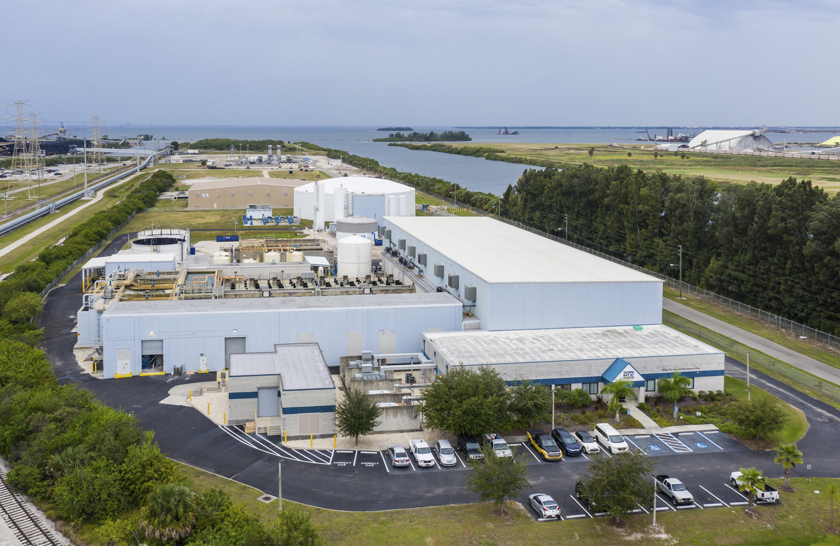
SWIFT II Funding
Tampa Bay Seawater Desalination Plant
Photo courtesy of Tampa Bay Water.
Council Item 24-0095
Delegating the authorization for the issuance of utility system revenue improvement bonds
(SWIFT II Tranche 2)

Slide 4
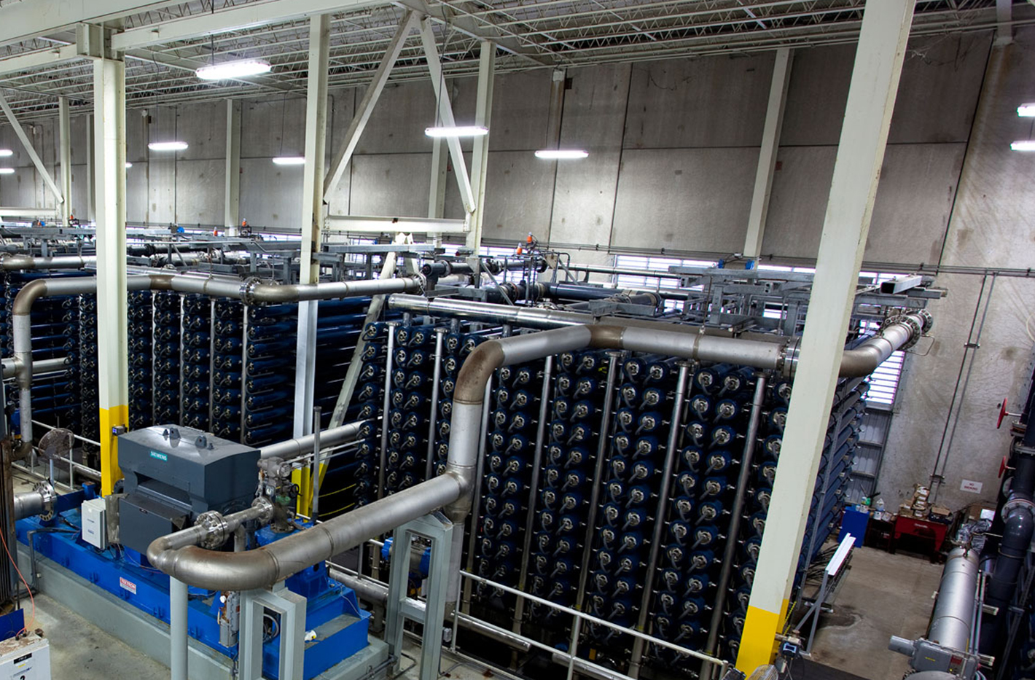
SWIFT III Funding
Tampa Bay Seawater Desalination Plant
Photo courtesy of Tampa Bay Water.
Council Item 24-0111
Delegating the authorization for the issuance of utility system revenue improvement bonds (SWIFT III Tranche 1)

Slide 5
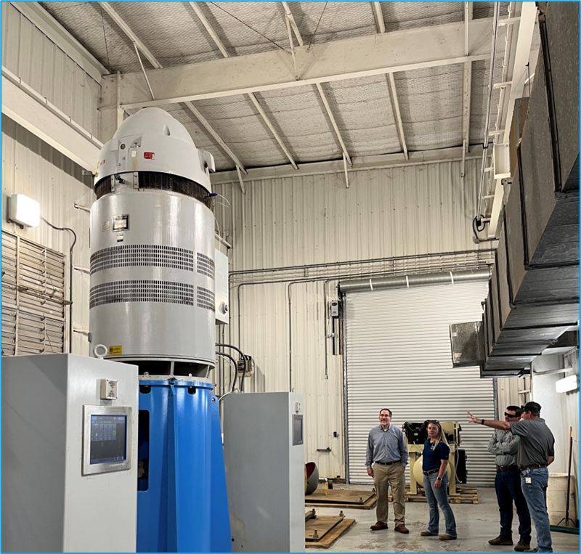
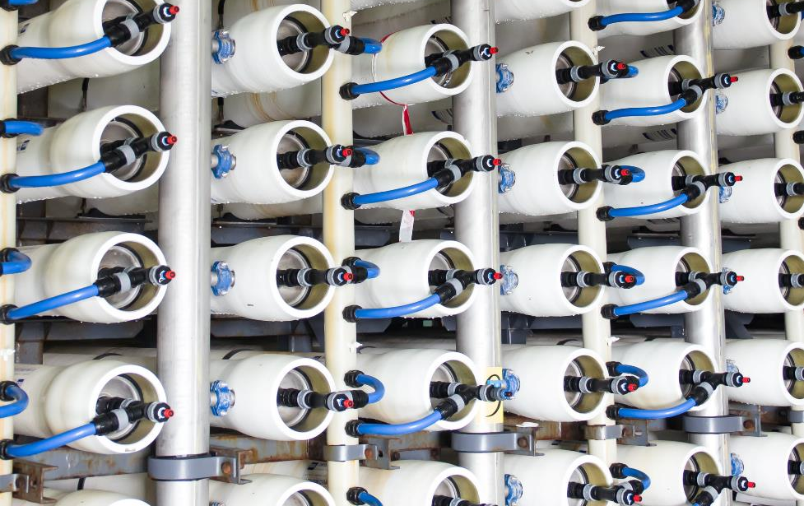
Bureau of Reclamation Grants
Council Item 24-0098
Ordinance authorizing the execution of all documents necessary to apply and accept the U.S Bureau of Reclamation’s Grants

Slide 6
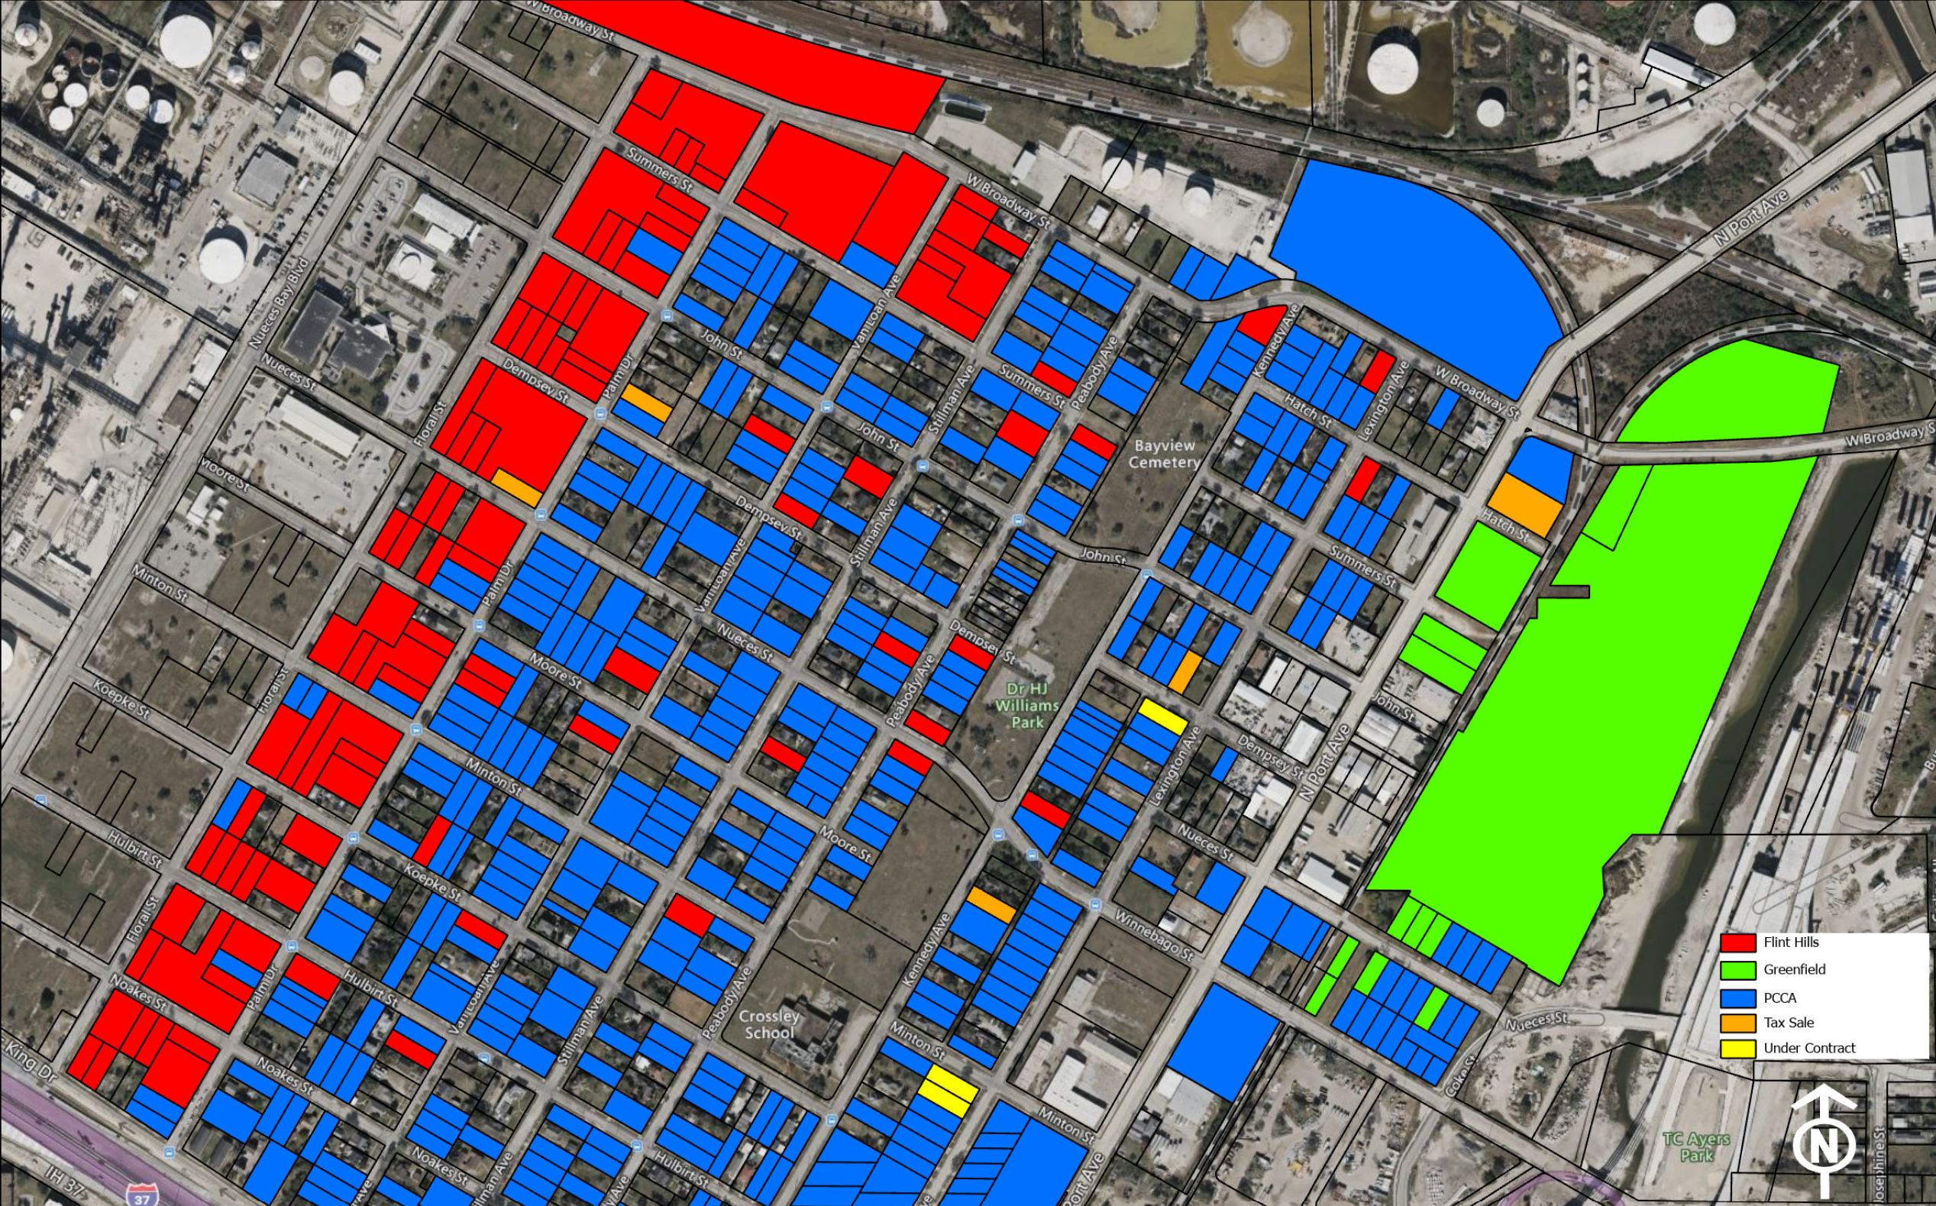
AEP Power Agreement
Council Item 24-0072
An agreement between the City and AEP to authorize execution of all documents necessary to construct 138 KV substation
Substation

Slide 7
Master Services Agreement Amendment
Council Agenda Item 24-0073
Risk matrix
Design criteria package
Progressive Design Build (PDB) agreement (Contract)
PDB Request for Qualifications (RFQ)
RFQ Response reviews and shortlist
PDB Request for Proposals (RFP)
RFP response review and ranking
Contract negotiation and recommendation

Slide 8
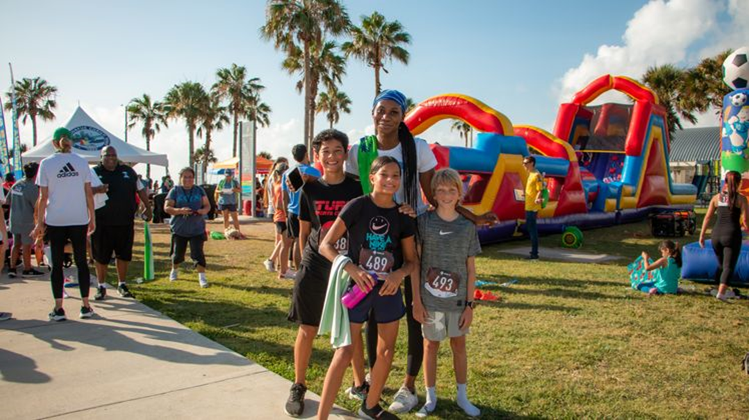
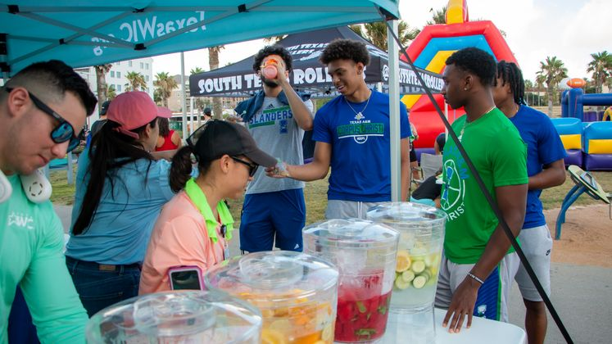
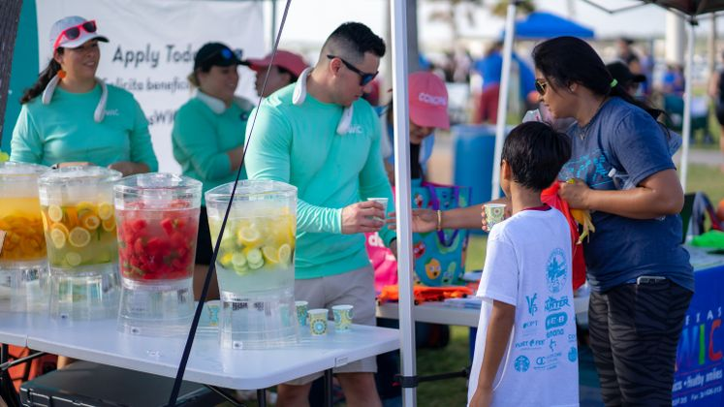
The Cost of a New Water Supply for the Region
Who will it benefit?
Who will pay for it?
What are the rate impacts?
We’re all in this together

Slide 9
Customer Cost
Average residential customer using 6,000 gallons per month
Preliminary rate analysis includes existing water projects

Slide 10
Project Timeline Going Forward
Delivery Team Selected
Guaranteed Maximum Price (GMP)
Preliminary Services
Final Design & Construction
Permits
Received
RFQ/RFP
Piloting
Substantial
Completion
Final
Acceptance
100%
Design
Permitting
Predesign/Design
Early Construct/Procurement
Construction
Ops Support
Feb 2024
Nov 2024
Early 2026
~Late 2027
~2028

Slide 11
Community Outreach Plan
Partnership Strategy
Interactive educational booths at community events
Speaking engagements with local civic groups
Speaking engagements with professional organizations
Stakeholder meetings in the Coastal Bend and beyond
Media and Advertising Strategy
News coverage
3-minute video segment
Radio interviews
Website/social media updates

Slide 12
Thank you!

