Slide 1
Water Resources Update Corpus Christi City Council August 16, 2022

Slide 2
Seawater Desalination
City staff anticipating water rights permit application for Inner Harbor to go before TCEQ commissioners on September 22, 2022
City legal team reviewing Flint Hills revised contract for land acquisition of Inner Harbor; will return to Flint Hills in 10-15 days
AEP has received contract for Inner Harbor power study and work order has been issued; estimated time of completion 10-12 months
FNI is currently 1-month into a 12-month process working with U.S. Army Corps of Engineers on permitting for Inner Harbor
City staff preparing amendment to FNI master service agreement to add additional tasks such as surveying and land acquisition for La Quinta Channel

Slide 3
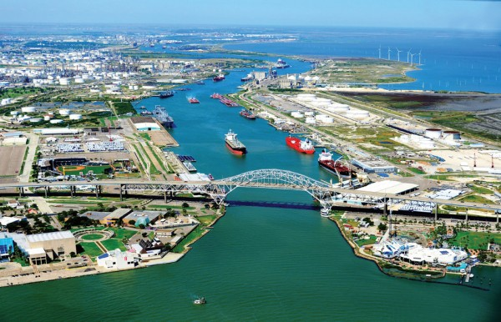
Seawater Desalination (Cont.)
Water Rights Permit Applications
Inner Harbor
Received by TCEQ: 1/22/20
Administratively Complete: 2/26/21
Public Meeting: 3/18/21
La Quinta
Received by TCEQ: 1/22/20
Administratively Complete: 5/5/20
Public Meeting: 10/15/21
TPDES (Discharge) Permit Applications
Inner Harbor
Received by TCEQ: 1/22/20
Administratively Complete: 5/22/20
La Quinta
Received by TCEQ: 1/22/20
Administratively Complete: 3/13/20

Slide 4
Other Potential Water Supplies
Evangeline
City staff and City Manager met for the 3rd time to discuss options (cost, delivery method)
Reuse
City working towards potentially extending water reuse lines leaving all six (6) of our Wastewater Treatment Plants
Barney Davis
City staff working towards desktop proposal for an evaluation of the site
Aquifer Storage and Recovery
City staff met with HDR to review 2019 project plan and discuss additional work needed to update
CC Polymers
City staff, City Manger and Council Members met with stakeholders

